Slide 1

Search Driven Apps
Notes:
Joe Zack, dev, podcaster
Search engine driven applications
I’ve used search engines in eCommerce for a long time, but recently I spent some time taking another look at them to try and figure out if they were an appropriate solution for something I was doing at work.
While I was doing that research, I came up with a few different archetypes that I thought fit really well with search engines do and so I thought it would make for a cool talk!
Define the problem
How they solves it
Demonstrate 3 types of apps
Go do it!

Slide 2
The problem?
StackOverflow does 34M searches per day
Google servers 40k searches…per second
Amazon sells over 500M products
Splunk indexes 100’s of TB per day
Notes:
Search is a core tenet of the modern usability
It’s a huge part of how we interact with world
Google obviously, but think about how important search is to other experiences: Cortana, Spotlight, Alexa
You can hardly use the telephone, listen to music, buy underwear, or even watch “tv” without some sort of search. Imagine explaining that to your grandparents grandparents!
But…we humans aren’t very good at it.
We typo, don’t know what we’re looking for
As a dev, I’m really interested in building tools that ease the interactions between humans and data and search is a huge part of that.
--
How are these interactions are built
https://ardorseo.com/blog/how-many-google-searches-per-day-2018/
https://www.scrapehero.com/many-products-amazon-sell-january-2018/
https://stackexchange.com/performance

Slide 4
https://www.eetimes.com/author.asp?section_id=36&doc_id=1330462
Notes:
Search is a core tenet of the modern usability
It’s a huge part of how we interact with world
Google obviously, but think about how important search is to other experiences: Cortana, Spotlight, Alexa
You can hardly use the telephone, listen to music, buy underwear, or even watch “tv” without some sort of search. Imagine explaining that to your grandparents grandparents!
But…we humans aren’t very good at it.
We typo, don’t know what we’re looking for
As a dev, I’m really interested in building tools that ease the interactions between humans and data and search is a huge part of that.
--
How are these interactions are built
https://ardorseo.com/blog/how-many-google-searches-per-day-2018/
https://www.scrapehero.com/many-products-amazon-sell-january-2018/
https://stackexchange.com/performance

Slide 5
The Elephant in the Room: RDBMS
Atomicity, Consistency, Isolation, Durability
Transactions
Mature
Advanced features like full text
Notes:
First up, lets address the elephant in the room
Ultimately the apps I’m going to show you today can absolutely be built on a traditional sql databases, but YOU, the dev, are going to be doing a lot of extra work
Slowly and poorly reimplimenting features that already exist in search engines
Designed specifically for common search use cases
Relational databases are mature, robust solutions
They’re great at storing and retrieving data, and they’ve matured really well.
They’re really good at transactions
The standard argument that they don’t scale horizontally well, ”web scale”
Atomicity, Consistency, Isolation, Durability
Basic Availability, Soft State, Eventual Consistency

Slide 6
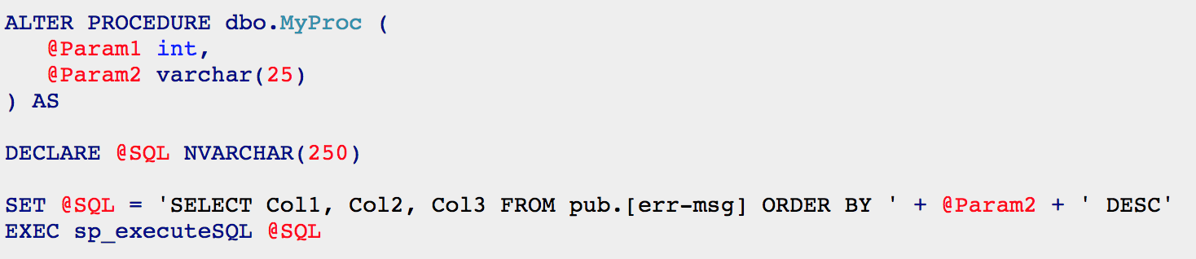
Dynamic queries though...
Notes:
I also wanted to point out, that the coding you’re going to be doing isn’t very pretty!
The more complex your data set, the more funky sql generation you’re going to end up doing
Either by hand, or ORM…either way: no fun
-----------------
RDBMS are not so good at complicated queries
ANSI SQL is really limited, and crusty, and once you get to a point – you end up having to create dynamic queries
String building, which is particularly annoying when you’re doing dynamic parameterization
Ever written code like this?
It starts out innocently enough, just a simple like search. Then you start searching other fields.
This is what it takes to sort by properties dynamically, can anyone tell me what’s wrong with this approach?
Sql injection
Dynamic “IN” clauses, One to many, temp tables, group by, dynamic columns, CTE, pivots
Query optimizers are not so good at executing dynamic sql either, they really want to compile their stored procedures and reuse the plan. They’re not optimized to deal with procs that run wildly different queries every time you run them.
Next thing you know you’re dynamically adding joins, and creating temp tables, group by, LIST_CONCAT, CTE, pivot, dynamic sorting, temp tables
You’ve got if statements for this and for that…and if you’ve got paging, and need to support multi-page actions…
You’ll bump into interesting edge cases – like the fact you can’t have procs that populate temp tables, calling procs that populate temp tables.

Slide 7
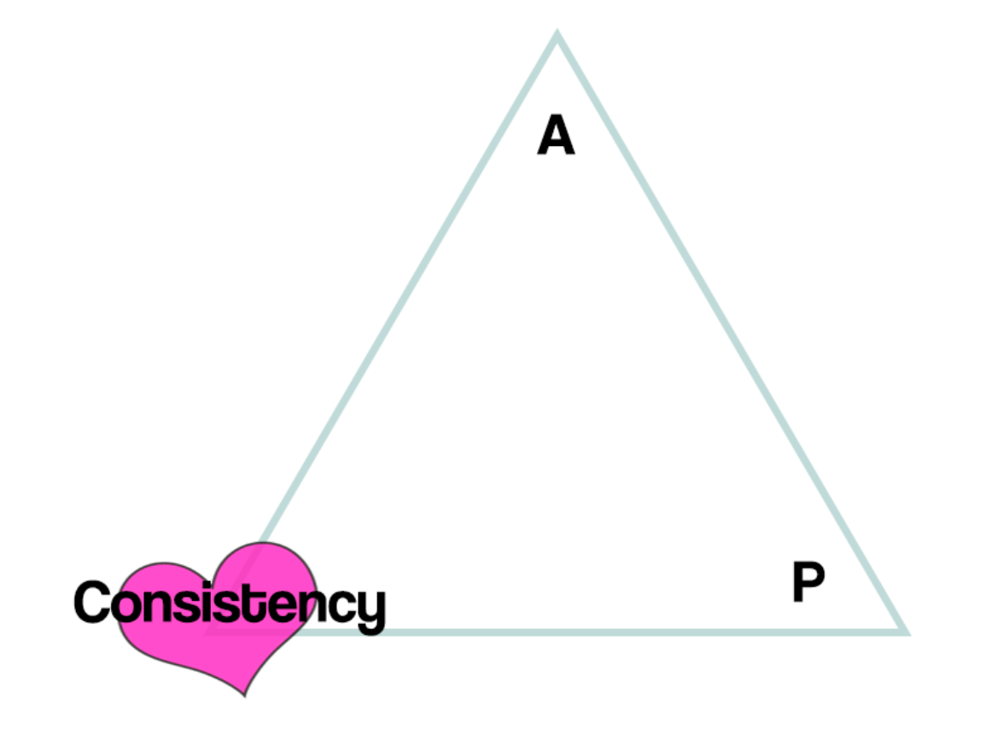
Relational DB
Don’t scale horizontally very well
Designed for ACID instead of BASE
Shredding is inefficient
Writing dynamic ANSI SQL is the pits
Notes:
Relational database aren’t optimized for searching
Atomicity, Consistency, Isolation, Durability
Basic Availability, Soft State, Eventual Consistency

Slide 8
When your query is still running after 2 minutes and you see your face reflected in the IDE
Notes:
You also have to manage performance yourself!

Slide 9
Is it worth it?
Notes:
There is one huge pro to SQL, you’ve probably already need it for some other reason
why extend your technical footprint?
That’s a good question to ask
A search engine really needs to bring a LOT of value in order for you to consider adding it to your solution
…so, from here on – lets focus on that what we get
So you can figure out if the overhead is worth it

Slide 10

What do we want out of search?
Easy for the user to use
Fault tolerant
Integrates easily
Configurability
High Scalability
Wicked fast
Low code
Notes:
By “low code”, I mean I focus my coding efforts on the unique problems that I’m solving in my domain
https://www.pexels.com/photo/portrait-of-young-man-326559/

Slide 11
Designing a Search Engine No baggage edition
Wants | Solution
Integrates easily | Web Services
Configurability | JSON
High Scalability | NoSQL
Wicked fast | Index all the things
Low Code | Meta data driven
Notes:
How would we design a search engine, if we didn’t already have the inertia/baggage of our existing technologies
Made a little list with some of the things we want, and some common solutions to those problems
Well… you just invented a search engine
You could roll your own thing
Index: – save meta data, about my data, to make searching faster, trading off up front processing time, for fast retrieval
Low code: Highly dynamic, do the heavy lifting for me
Just like sql, you could do this yourself.
Or you could use a modern search engine that has taken that starting point and evolved it for 20 years
(Lucene released in 1999)

Slide 12
For the example apps…
Text Search
Stop Words
Stemming
Synonyms
Fuzzy Searching
Relevance tuning
Import
Aggregation/Filtering
Aggregates
Auto-Bucketing
Ranges
One-To-Many
Auto Complete
Monitoring
Streaming data
Dashboards
Visualizations
Index Management
Notifications
Notes:
Quick shot of what I got out Elasticsearch for the demo apps
These are common features of search engines, because it’s the kind of stuff that we (as a human) expect to just happen
The ways we interact with a search engine are really basic: Either you type in the text box, or maybe you click a few check boxes
Wanted to get all these points on one slide to show you that despite the simple interface, and simple apps, there can be a lot going on.

Slide 13
How search engines work
Notes:
What’s the secret sauce?
Search engines are optimized for searching
They’ve given up on ACID
They’ve decided to do more work up front, storing and organizing data, in order to make retrieval and counting much faster
The secret here is the underlying data structure: Inverted Index
Similar to denormalizing your data, and indexing everything

Slide 14
Search Vocab
Index
Shard
Keywords
Term
Filters

Slide 15
Notes:
WARNING: Coloring with Crayons
Fast lookup O(1)
Counts, Aggregates
When I said “index everything”
Search engines make heavy use of what is called, a inverted index.
Sounds like it might be a bit complicated, but really
We just take the important bits out of our data, store it as keys in a hash table
The value in the hash is a vector of pointers back to our original data
Hashes are ruthlessly efficient at lookups, but they data you’re storing will end up taking up a lot more room than the size of the data
Inserts and updates aren’t so great either, simple example above the first sentence represents 8 inserts, potentially on different machines
Additionally, the size of the data is about double since every important word is stored again.
Thankfully the modern search engines are good about compressing the data, so things in practice end up being better than that.
Sorting, Elasticsearch uses a combination of...
• Term/Document frequency (how often a term appears in a result, and how common that term is)
• Field length (ie: results from shorter fields (like title) can be boosted)• Some other weird stuff like coordination factors, and vector space that I don't understand
Fox book example:
Encyclopedia
Book on Foxes
Scoring Theory: https://www.elastic.co/guide/en/elasticsearch/guide/current/scoring-theory.html
Lucene (and thus Elasticsearch) uses the Boolean model to find matching documents, and a formula called the practical scoring function to calculate relevance.
On sorting: term frequency/inverse document frequency and the vector space model but adds more-modern features like a coordination factor, field length normalization, and term or query clause boosting.

Slide 16
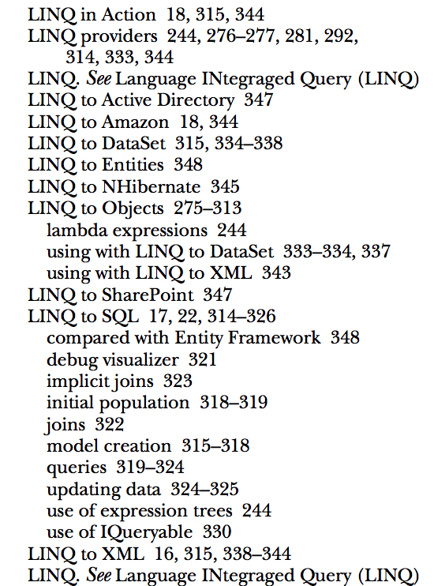
Inverted Index
Notes:
Now I’ve been saying ”Hash” table, because that’s a common programmer-y data structure
But search engines call it an index, because it’s a bit more specialized – but in practice it’s not that difference from an index in a book.
Remember those?

Slide 17
Inverted Index Search Engines
Inverted Index Database
Slow to Write, Fast to Read
NoSql before it was called NoSql
Scale Super Well
Wicked Fast Lookups
Support Complex Filters
Allow for easy scoring of data
Notes:
Pulling the data back out from somelike SQL, means putting the data back together, every time you retrieve
SQL is heavily biased towards atomicity and consistency, but it’s not super great for searching
Scoring is really important

Slide 18
Natural Language is complicated!
Stop words: “the”
Phrases
Synonym: PWA = “Progressive Web Apps”
Stemming: run, runs, ran, running
Fuzzy searching (typos)
A lot of numeric stuff too!
Notes:
Some other benefits of those 20 years of evolution
Most of these are evolutions of the inverted index
Synonym example: Elasticsearch + Search Engine
When I process a document, I’ll insert an additional entry for one, if I see the other
Just like a traditional index, I’m trading up front work, for fast retrieval

Slide 19
Scoring is complicated!
Term/Inverted Document Frequency
Field length normalization
Coordination factors
Term/Clause boosting
Notes:
https://www.elastic.co/guide/en/elasticsearch/guide/current/scoring-theory.html#field-norm
Books with titles like “The Fox” or “North American Foxes” should rank higher than the Encyclopedia for the letter F
A lot of stuff going on here, and a lot of parameters that you can tweak
Documents that have a higher % of my term are probably more important
Shorter fields, that reference my term are probably more important
Other terms that have a strong correlation with my term are probably more important
Specific fields are more important (example: Date)

Slide 20
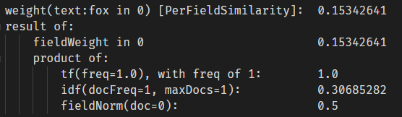
Pretty neat though, right?
Notes:
This is a nice example of the type of evolution that you’re missing out on if you attempt to build something custom

Slide 21
Notes:
Search is not just for natural language

Slide 22
Building Search Applications
Notes:
Summary:
What they do
How they do
Now lets take a look at leveraging the strengths of search engines to build useful experiences for humans

Slide 23
Elasticsearch vs….
Lucene
Solr
Cloud
Azure Search
AWS Cloudsearch
AWS ES
Notes:
Most support a basic Lucene style syntax, and more are built on Lucene
I won’t get too into the weeds on how that works, but the important bit is that Elasticsearch is king of the hill right now
2 reasons:
1: Really nice REST api, for building advanced filters
2. It's an ecosystem

Slide 24
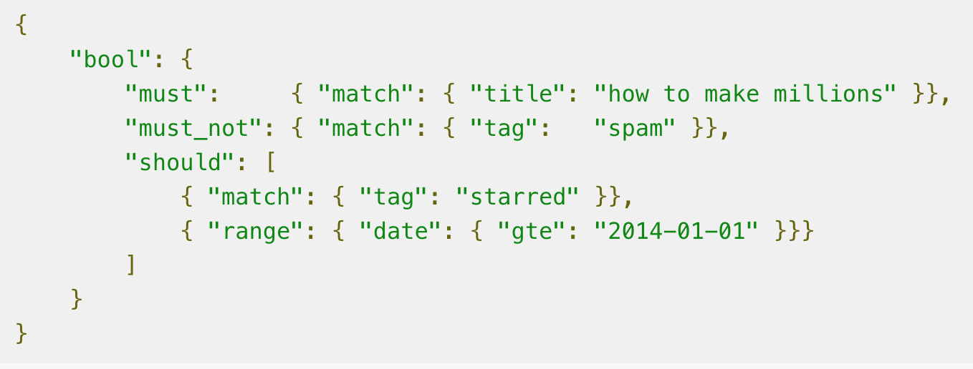
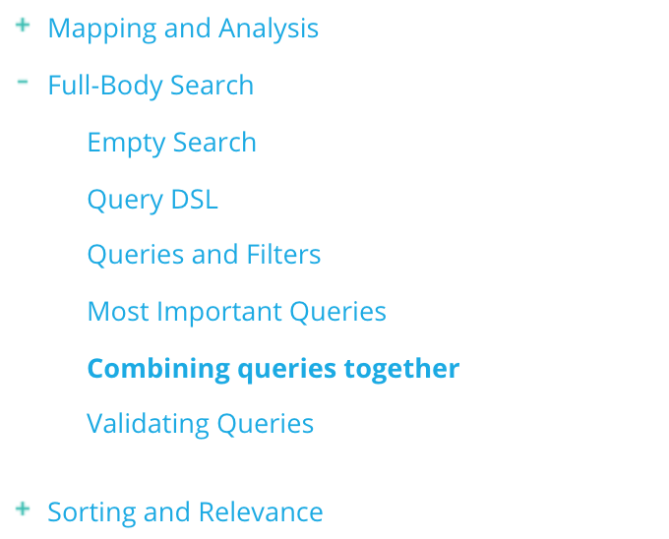
Reason #1: JSON
Notes:
How to make millions
Not spam
Should be starred
Should be more recent than April

Slide 25
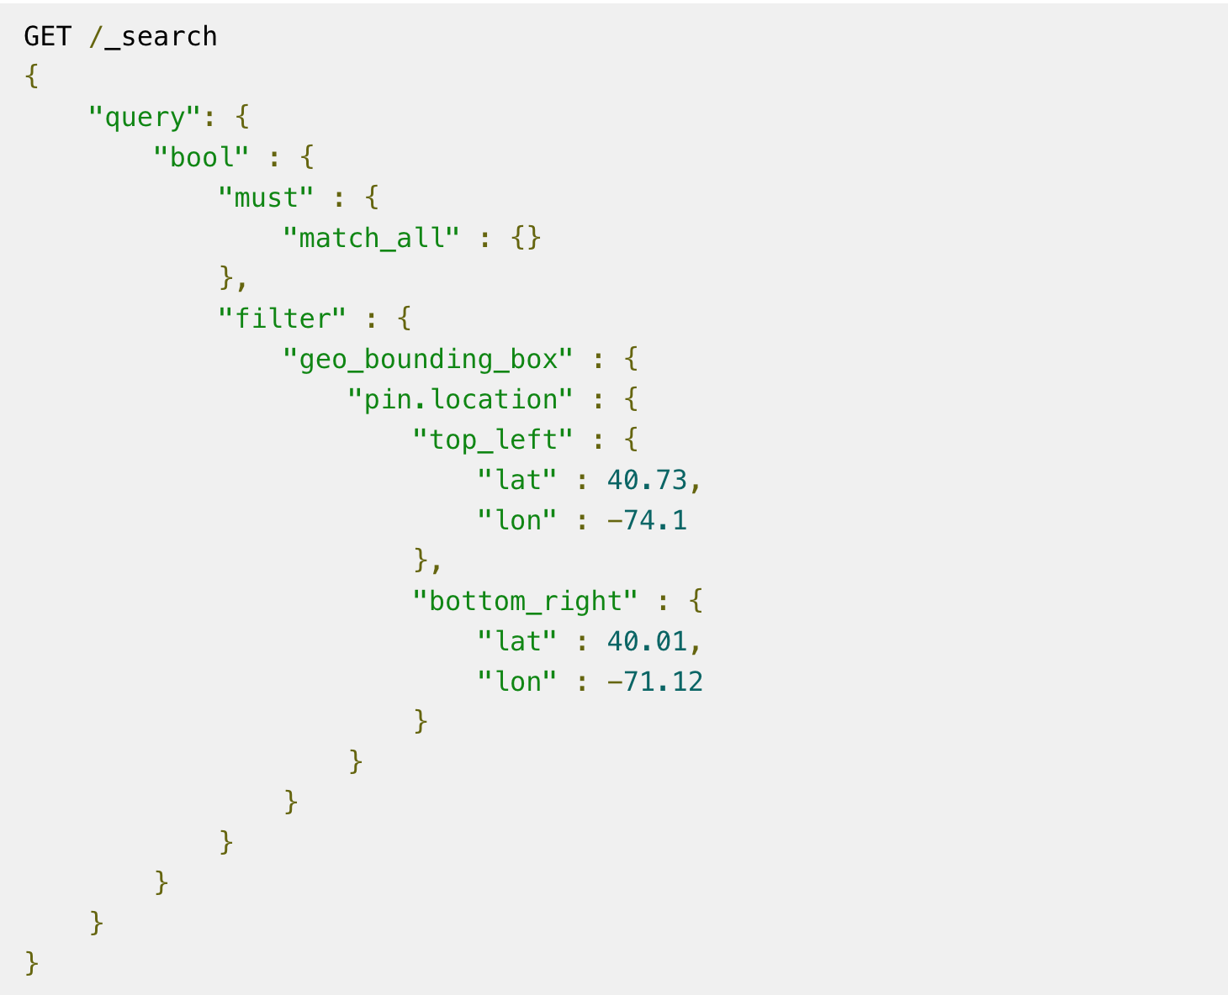
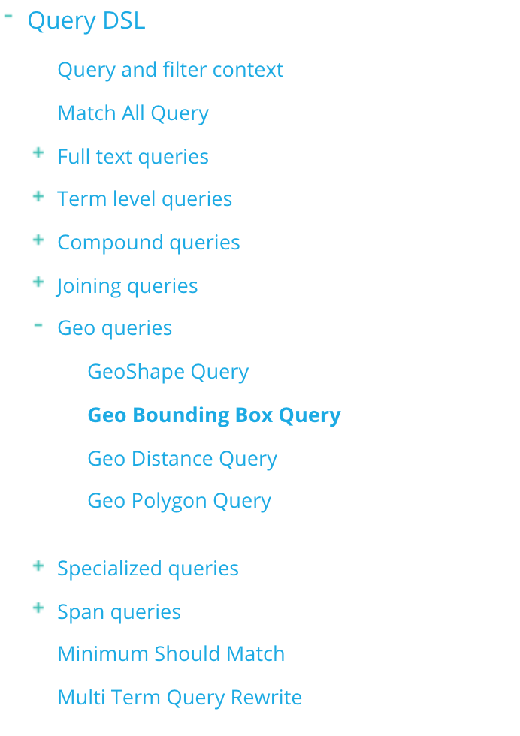
Geo-fencing in JSON
Notes:
Reason #1: Query DSL

Slide 26







#2: The Eco System
Notes:
Reason #2 The Elastic Stack
A host of products that are designed to work with and extend Elasticsearch

Slide 27
Interesting Extensions
Data ingestion
Anomaly Detection/Alert
Machine Learning
Analysis/Reporting
Security
APM
Notes:
Source available, but not necessarily free

Slide 28
Pricing…it’s complicated
Solution | Min | Max | Basic | REST, Ecosystem
Azure Search | Free | $1935 | ✓
AWS CloudSearch | $43 | $541 | ✓
AWS Elasticsearch | $13 | $5750 | ✓ | ✓
Elasticsearch Service | $16 | $952 | ✓ | ✓
Note: prices are per month, per node, and do not include data transfer
Notes:
Tough to compare Apples to Apples
Wide Spectrum

Slide 29
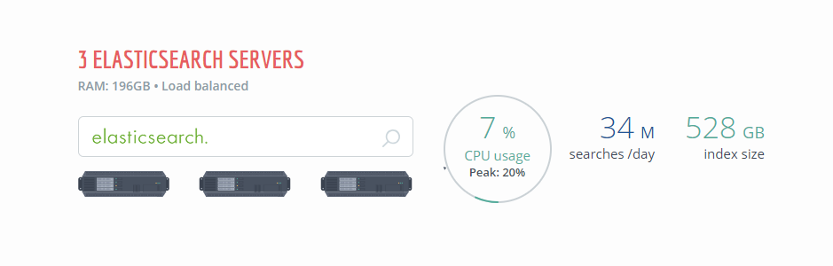
Stack Overflow

Slide 30
Search Archetypes
Text search
Aggregation and Filtering
Near Real-Time Monitoring
Notes:
Something like….
Google
Amazon
Splunk
Elasticsearch caching layer

Slide 31

#1 Text Search
Notes:
See those auto-suggest?

Slide 32
Podcast Search
Stop Words
Stemming
Synonyms
Fuzzy Searching
Trivial import
Notes:
I got this all with JSON!

Slide 33
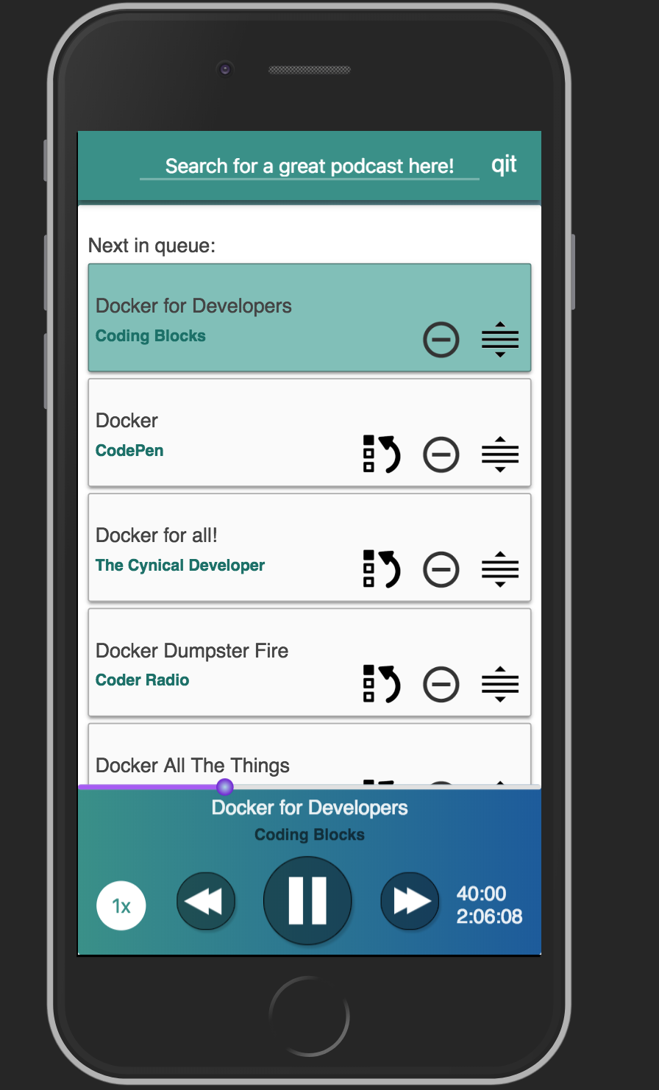
QIT.cloud
Notes:
Indexes about 7,000 episodes
Query it in about 0 seconds, rounded up
Search engine allows us to focus on UX

Slide 34


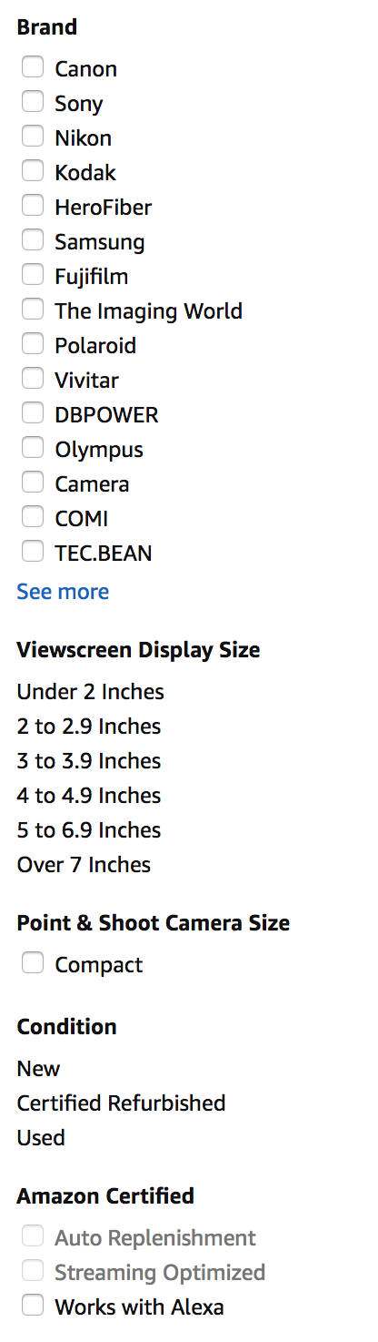

#2 Aggregation and Filtering
Notes:
80,000 for “camera’
In addition to the fuzzy search…
Sliced up the data in interesting ways:
One-to-Many relationships
Numeric Ranges
Custom Data

Slide 35
Board Game Browsing
Aggregates
Auto-Bucketing
Ranges
One-To-Many
Auto Complete
Relevance tuning
Notes:
Everything I said before, plus…

Slide 36
#3 Near Real-Time Monitoring
Notes:
Splunk DataDog
Difference here is
Windows 2012
Python 2.7
How does near real-time jive with the up front processing of indexes?
In practice, it’s not that slow, and most of the stuff we want to see graphed doesn’t need complex processing (synonyms, stop words, phrases)

Slide 37
APM
Dashboards / Graphs
Streaming data
Visualizations
Index Management
Notes:
Everything I said before, plus…

Slide 38
Logstash loads data
Python/Flask for users
APM X-Pack Plugin for monitoring
Kibana for Administration Elasticsearch for everything
Notes:
Elasticsearch at the heart
Data comes in via Logstash
The App is Python
Kibana is the admin
The APM XPac

Slide 39
This is how we do
Spin up the architecture in Docker
Create an index
Populate the data
Write some queries in Kibana
Make an App

Slide 40
Search Driven Apps
Notes:
Search Engines are specialized tools for building search interfaces for humans..
Talked about what problems they solved
Why they are so good at what they do
Demonstrated a bunch of common features via 3 apps

Slide 41
Learn
while you commute
100% free

Slide 42

Like this talk? Check out the show!
Joe Zack
@codingblocks
Notes:
Like this talk? Check out the show!

